Slide 1


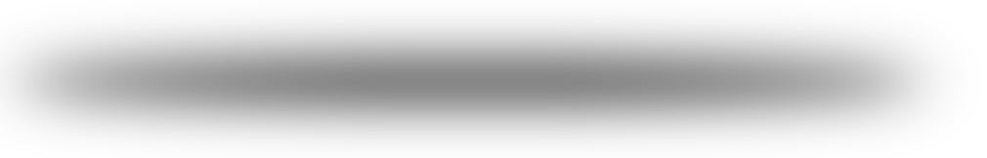
IMDb top Movies
Rawan Al-Qahtani
Ghadeer Alghamdi
Sypervised by: Dr.Mejdal Al-Qahtani

Slide 2

introduction
In this project we have used the IMDB movies dataset that was tacking from the website through web-scraping with beautiful soap. This data is for a 1000 movie containing (name-year released - show length –IMDB rating –audience votes – movie type –metascore –US gross
This data was used to create a module that can predict the IMDB rating from the other data(audience votes-year released - show length- metascore - US gross).
.

Slide 3

code sequence
Web scraping
Data cleaning
Data validation
Models application
Data visualizing
Predicting the top Movies

Slide 4

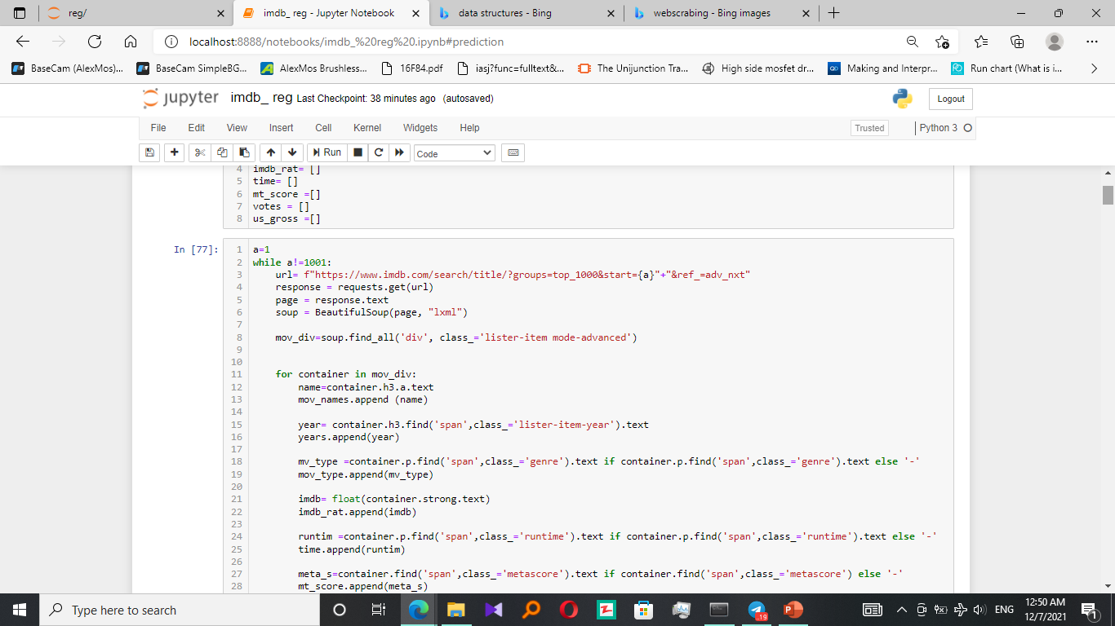
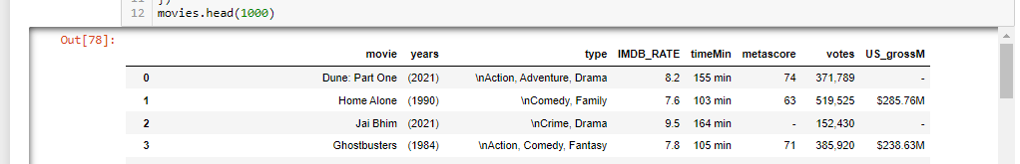
Web scraping
IMDB webpage was scraped to get dataset consist of 1000 movie with 8 categories for each.
this data was sorted into data-Frame

Slide 5



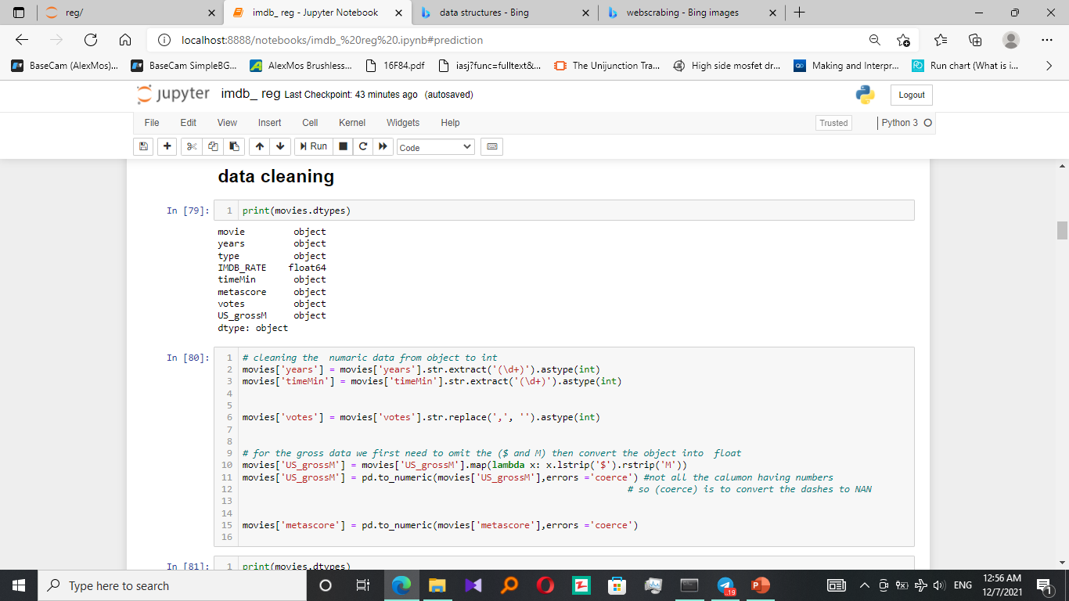
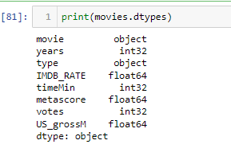
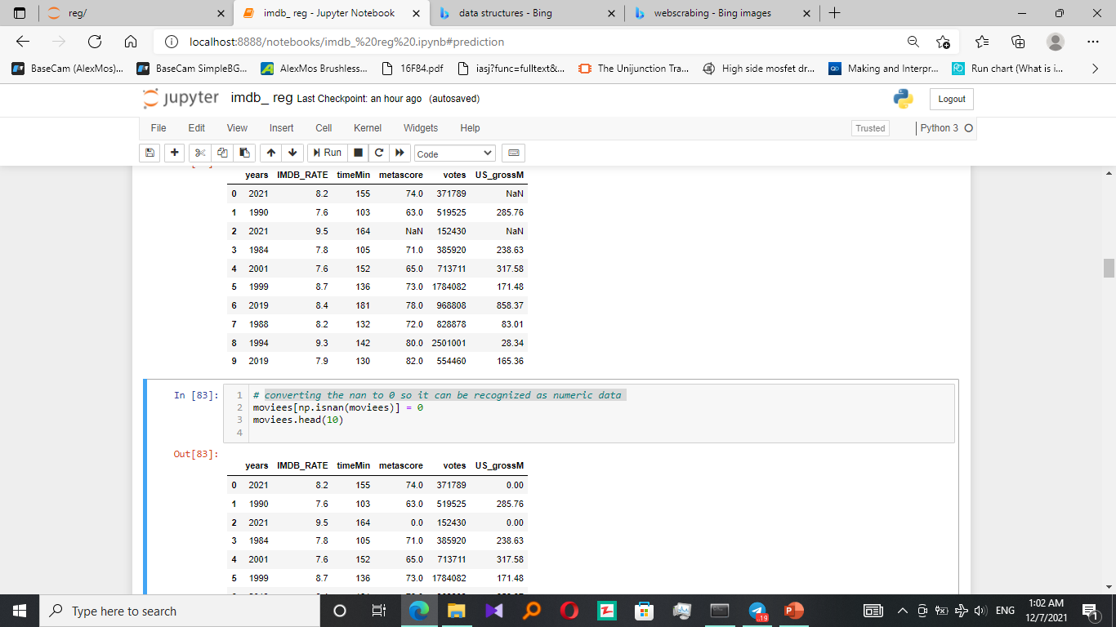
Data cleaning
cleaning the numeric data from object to int:
converting the nan to 0 so it can be recognized as numeric data:

Slide 6

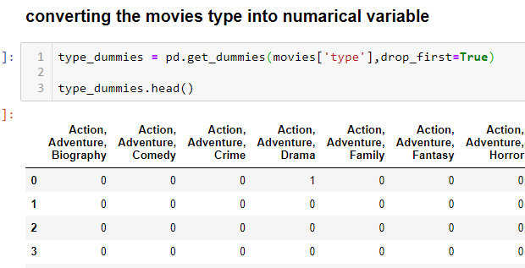
Data cleaning
convert the categorical data to numerical

Slide 7
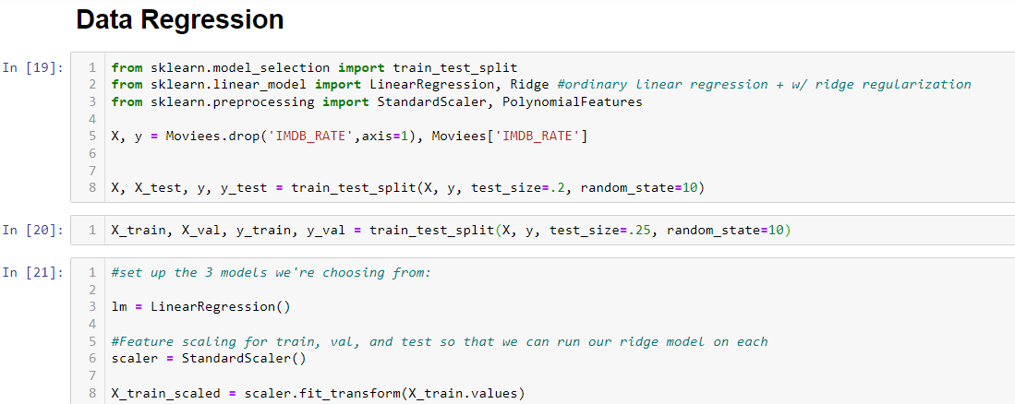
Creating the prediction module
Splitting the data to training_set 80% and testing_set 20%

Slide 8
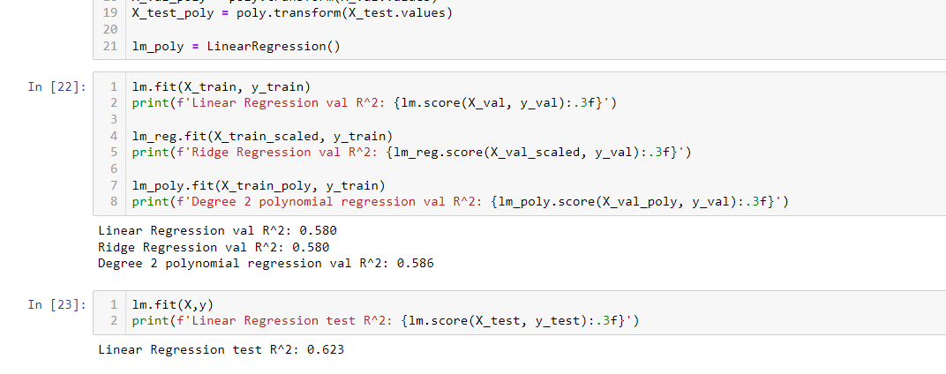
Creating the prediction module
The training score
The testing score

Slide 9
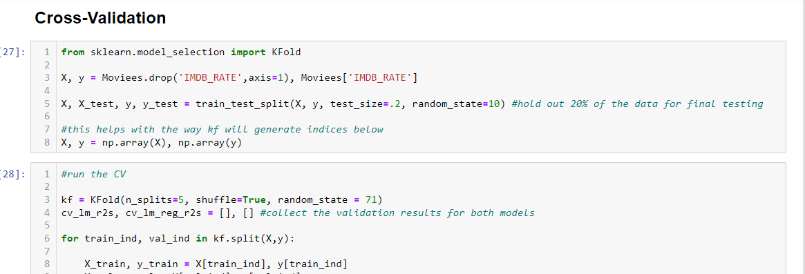
Data validation
To ensures that the ML model picks up the right (relevant) patterns from the dataset

Slide 10
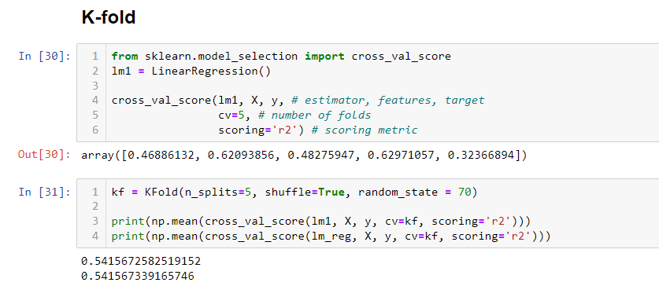
Data validation
The low scores are accepted in this module since one of its input is audience votes which is human nature that can’t behave in a predictable way or with certain pattern

Slide 11
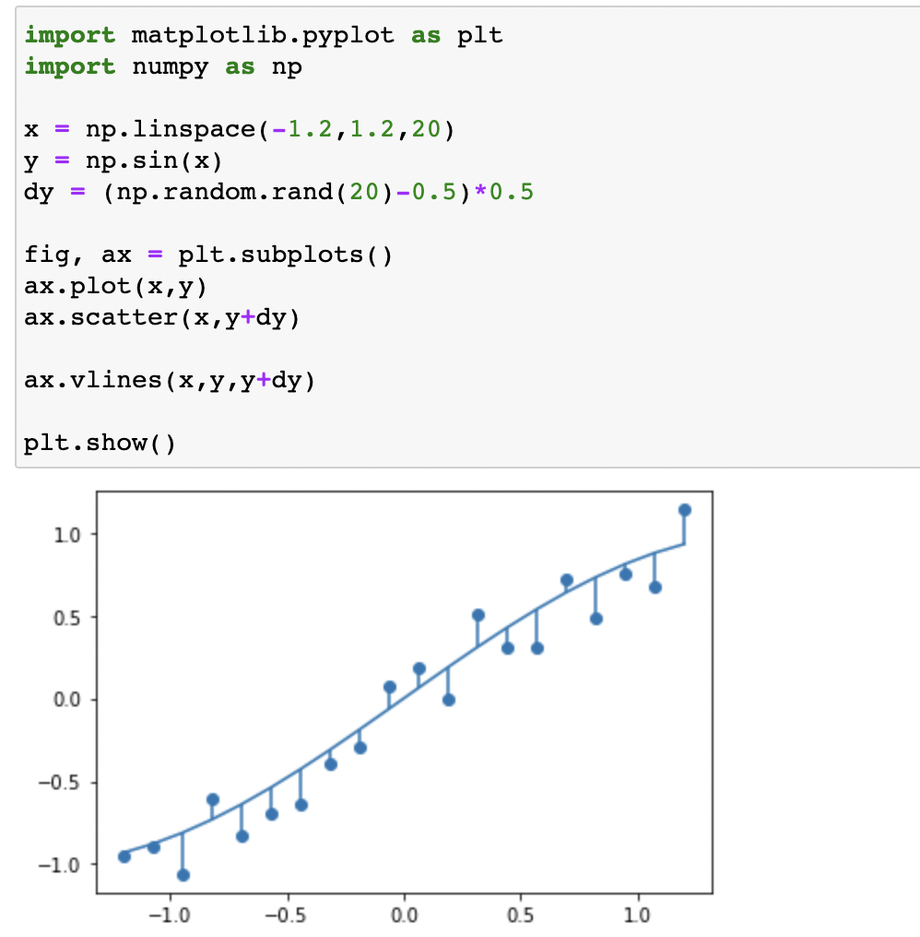
Plot residuals on a fitted model

Slide 12
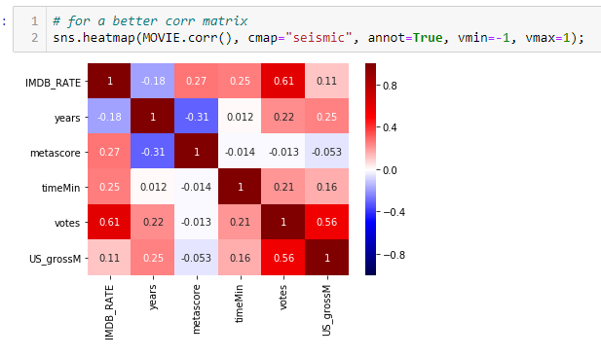
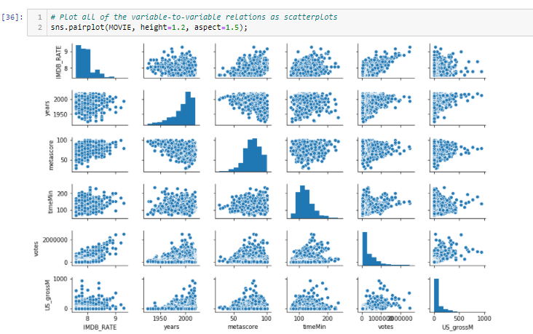
Data visualizing

Slide 13

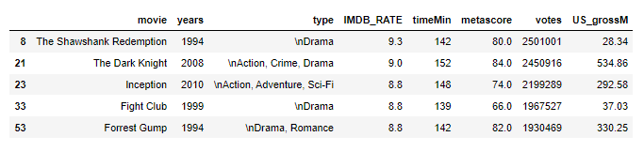
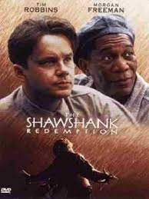

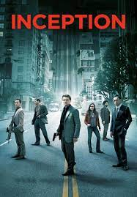
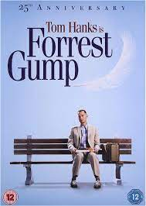
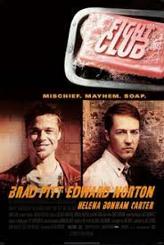
Predicting the IMDb rate to top 5 Movies
?

Slide 14
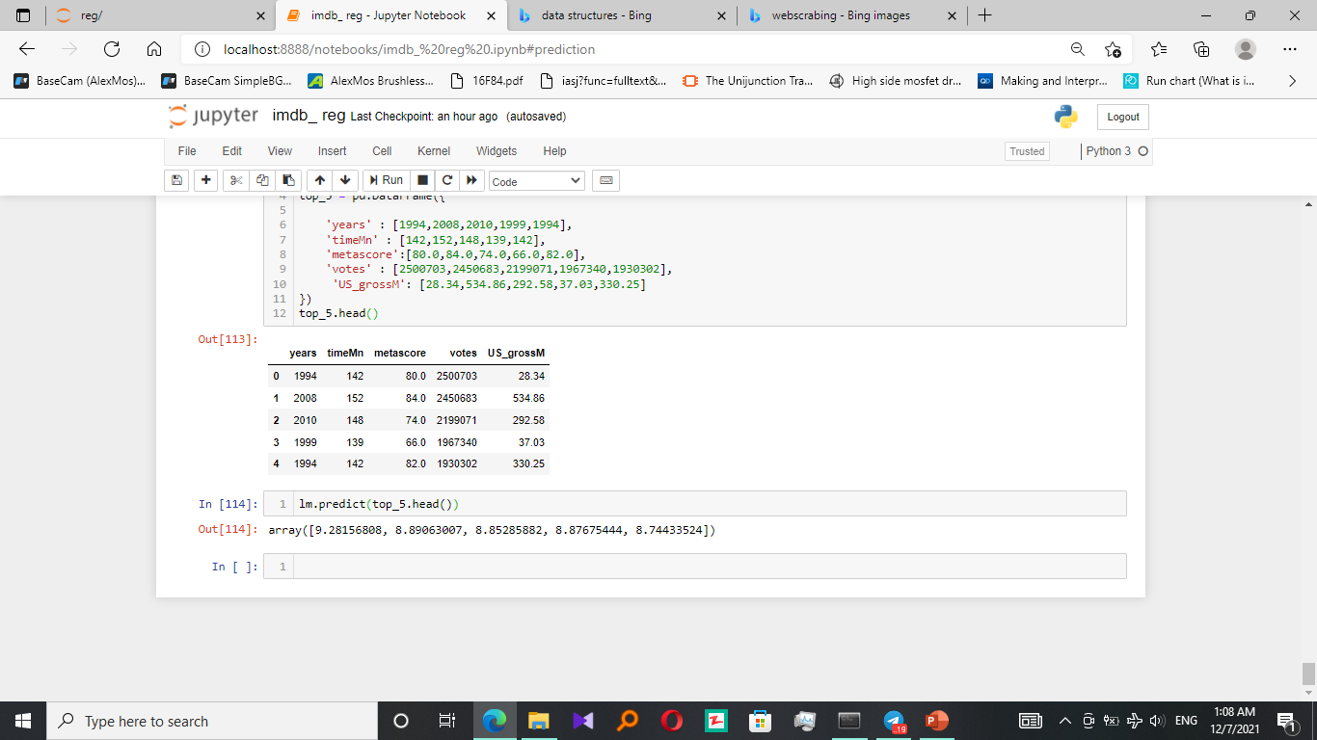
Predicting the IMDb rate to top 5 Movies
The real data
The input data to the prediction module
Comparing the output with the real data
The output data

Slide 15
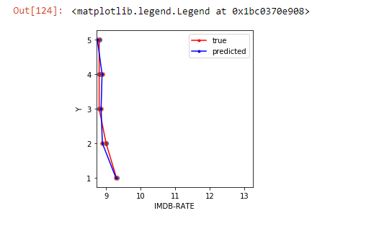

Predicting the IMDb rate to top 5 Movies
Comparing the output with the real data

Slide 16


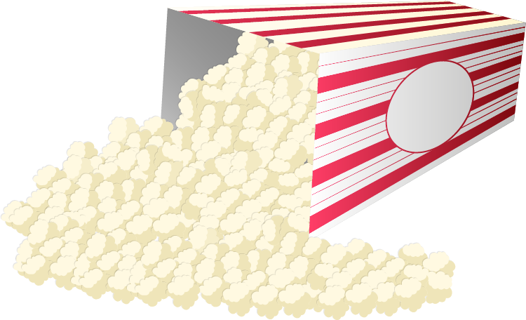


THANKS!

